Slide 1
WHAT IS THE MAJOR PREDICTOR FACTOR OF STROKE?

Slide 2
WHAT IS THE MAJOR PREDICTOR FACTOR OF STROKE?
Nasser Alnukhilan, Fahad Alkathiri, Osamah Alluhaidan, Abdulrahman Alanazi, Nawaf Bin Muhayni

Slide 3
Outline
01
02
03
04
05
06
INTRODUCTION
RISK FACTORS
DATA VISUALISATION
CORRELATION
CONCLUSION
QUESTIONS

Slide 4

01
INTRODUCTION

Slide 5

01
INTRODUCTION

Slide 6
INTRODUCTION
INTRODUCTION
Strokes remain a leading cause of death and disability globally. Understanding the risk factors associated with stroke is
crucial for early intervention and prevention strategies.

Slide 7
INTRODUCTION
Strokes remain a leading cause of death and disability globally. Understanding the risk factors associated with stroke is crucial for early intervention and prevention strategies.

Slide 8
Proportion of patients with a stroke: 4.87%
The proportion is significantly smaller than 50%, therefore we can conclude that the dataset is imbalanced.

Slide 9
MISSING VALUES
The healthcare dataset shows that the average Body Mass Index (BMI) of individuals is 28.893. as indicated by a high standard deviation of 7.854, with values ranging from a minimum of 10.3 to a maximum of 97.6. Additionally, the dataset contains 201 missing BMI values.

Slide 10
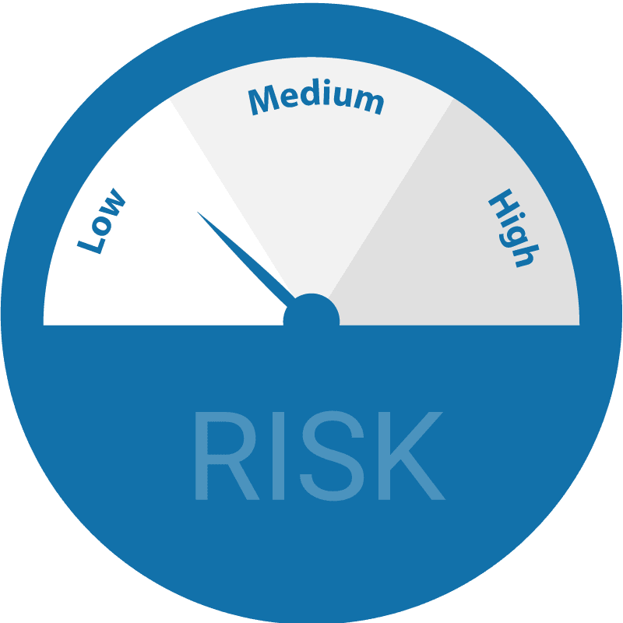
RISK FACTORS
Hypertension
Statues
Average
Glucose
Level
02
Age
Smoking
Status
Gender
Married
Statues
BMI
This Photo by Unknown Author is licensed under CC BY-SA-NC
Heart Disease
Statues
Residence Type
Work Type

Slide 11
RISK FACTORS
Age
Smoking
Status
Gender
Hypertension
Statues
Average
Glucose
Level
Heart Disease
Statues
Residence Type
Work Type
Married
Statues
BMI

Slide 12
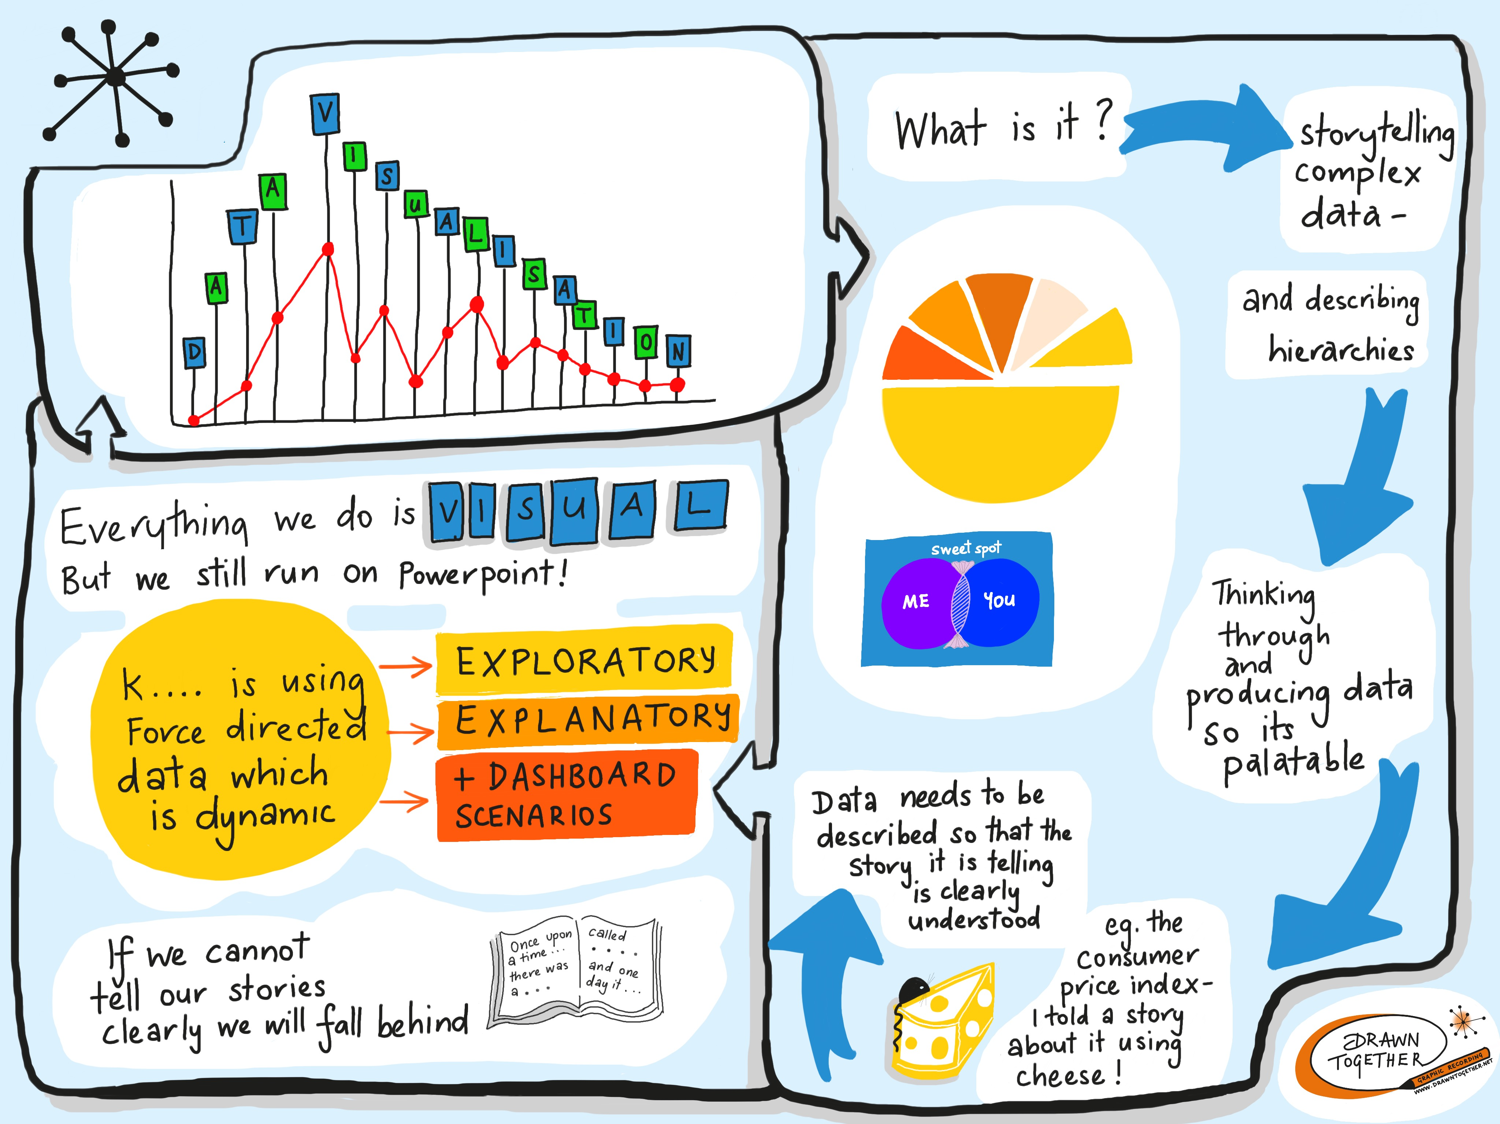
DATA VISUALISATION
03

Slide 13
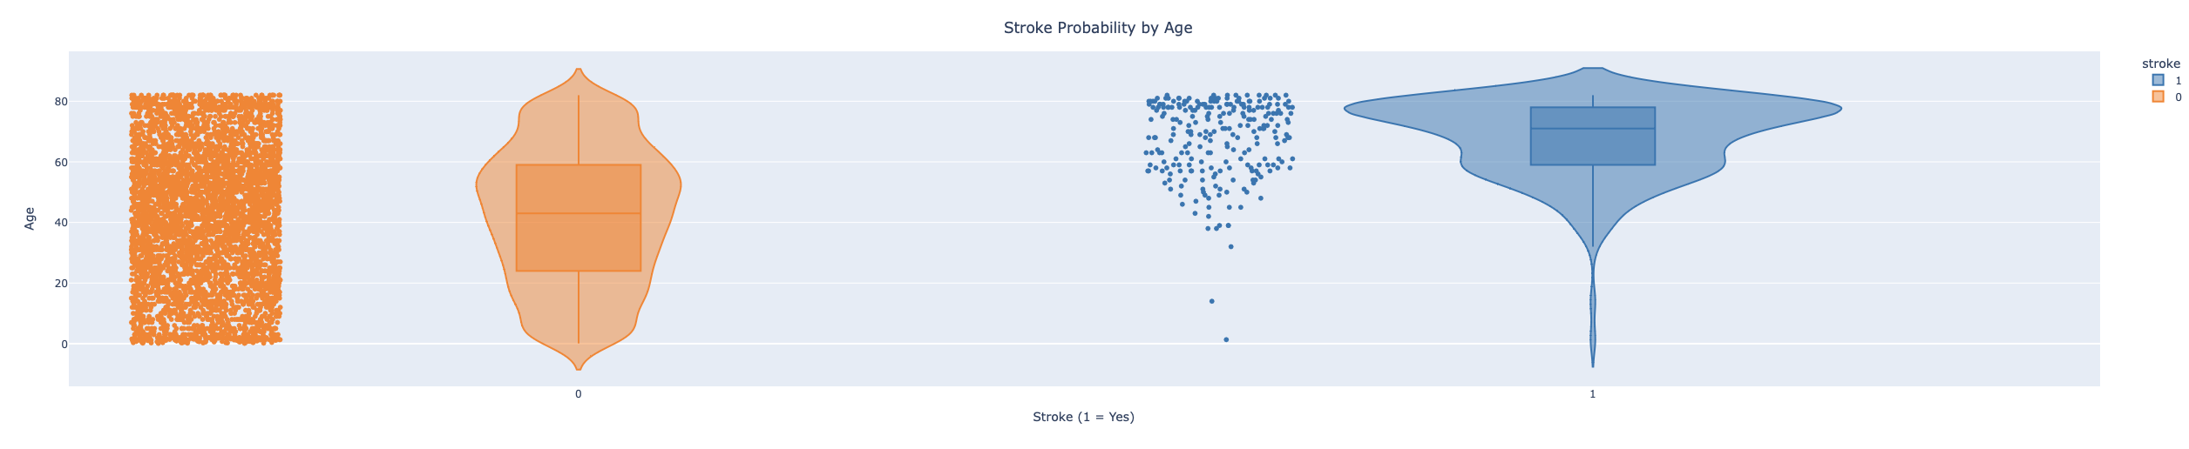
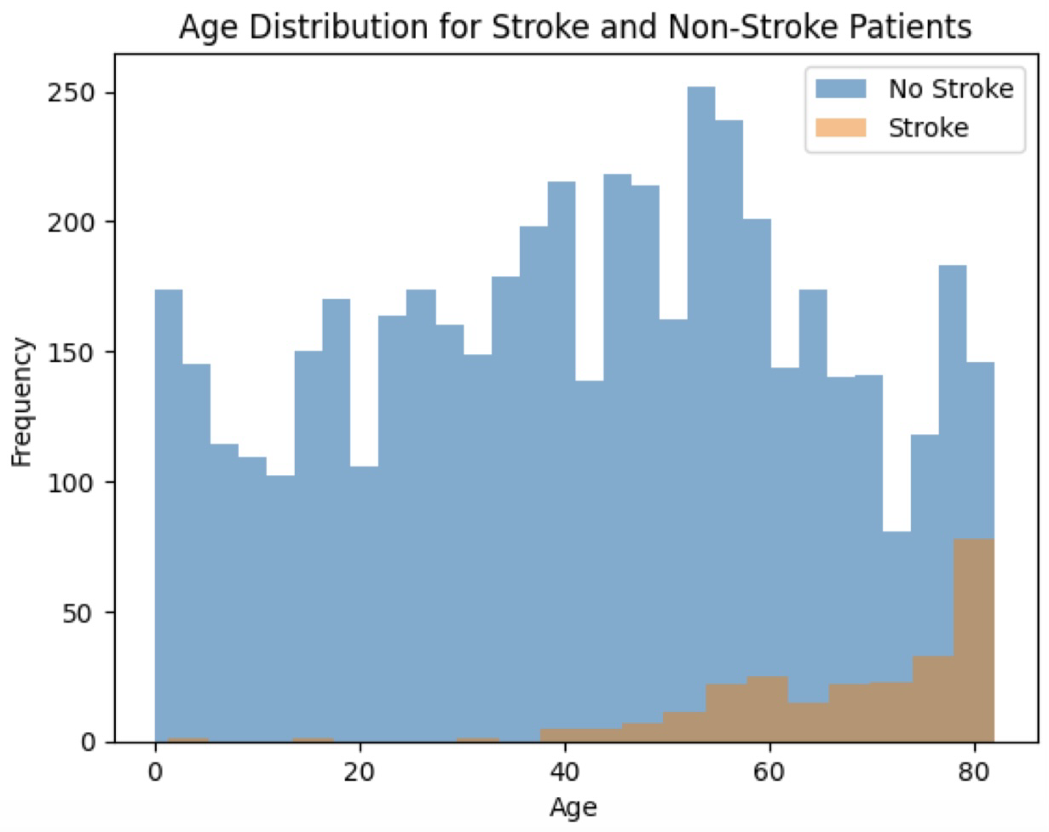
Age x Stroke
The plot illustrating the relationship between age and the occurrence of strokes indicates that the likelihood of experiencing a stroke escalates as individuals age, reaching its highest point among those aged 75 to 80. This pattern underscores the critical role of age as a determinant of stroke risk. While strokes are less common among younger individuals, occurrences are not unheard of in this demographic
The violin plot will display two distinct age distributions side by side: one for individuals who have experienced a stroke (denoted by a "1" on the x-axis) and another for those who haven't (indicated by a "0" on the x-axis).

Slide 14
Age x Stroke
The plot illustrating the relationship between age and the occurrence of strokes indicates that the likelihood of experiencing a stroke escalates as individuals age, reaching its highest point among those aged 75 to 80.
The violin plot will display two distinct age distributions side by side: one for individuals who have experienced a stroke (denoted by a "1" on the x-axis) and another for those who haven't (indicated by a "0" on the x-axis).

Slide 15
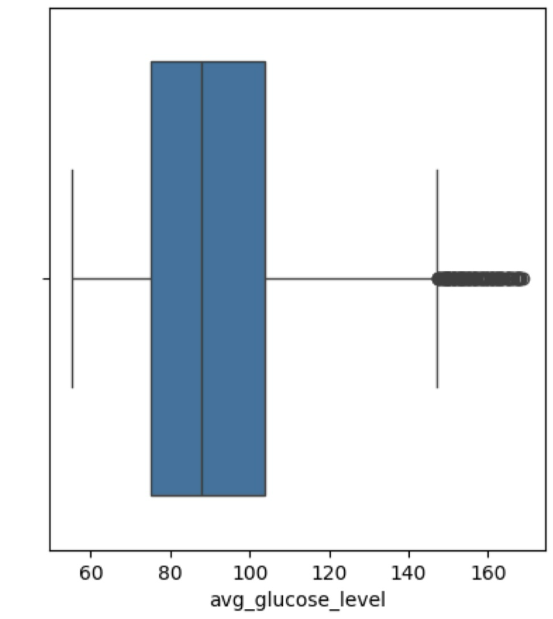
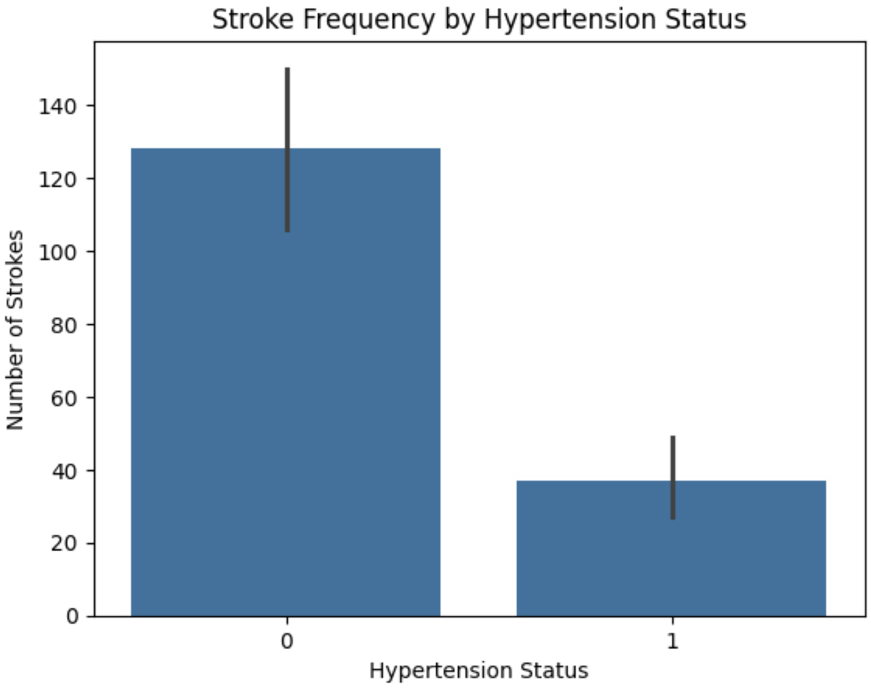
Average Glucose Level x Stroke
Hypertension
Statues
x Stroke
The provided plots suggest that individuals with higher average glucose levels and those with hypertension are more likely to experience strokes. As evidenced by a more pronounced difference in stroke occurrence between hypertensive and non-hypertensive individuals.

Slide 16
Average Glucose Level x Stroke
Hypertension Statues x Stroke
The provided plots suggest that individuals with higher average glucose levels and those with hypertension are more likely to experience strokes. As evidenced by a more pronounced difference in stroke occurrence between hypertensive and non-hypertensive individuals.

Slide 17
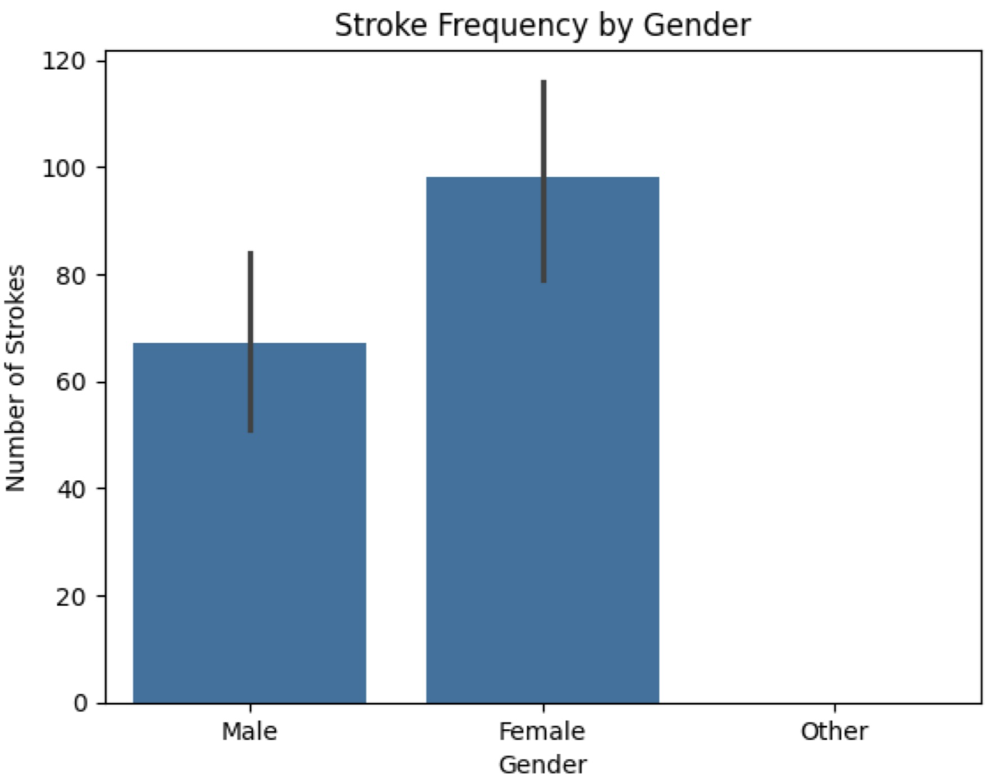
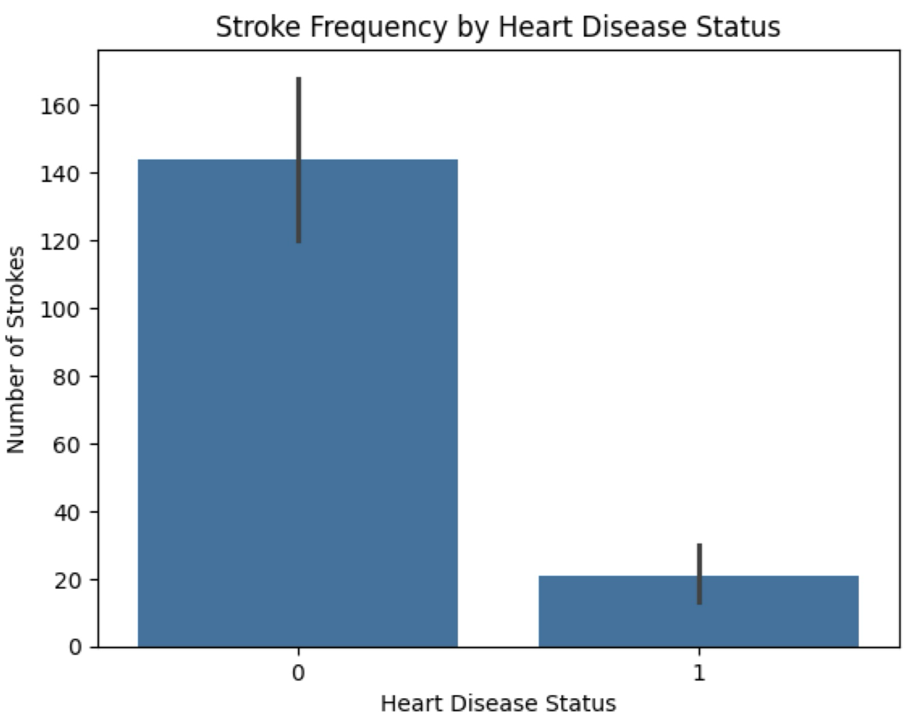
Other Factors
Other variables were also examined and tested for correlation with stroke. Like:
Gender x Stroke
Heart Disease Statues x Stroke

Slide 18
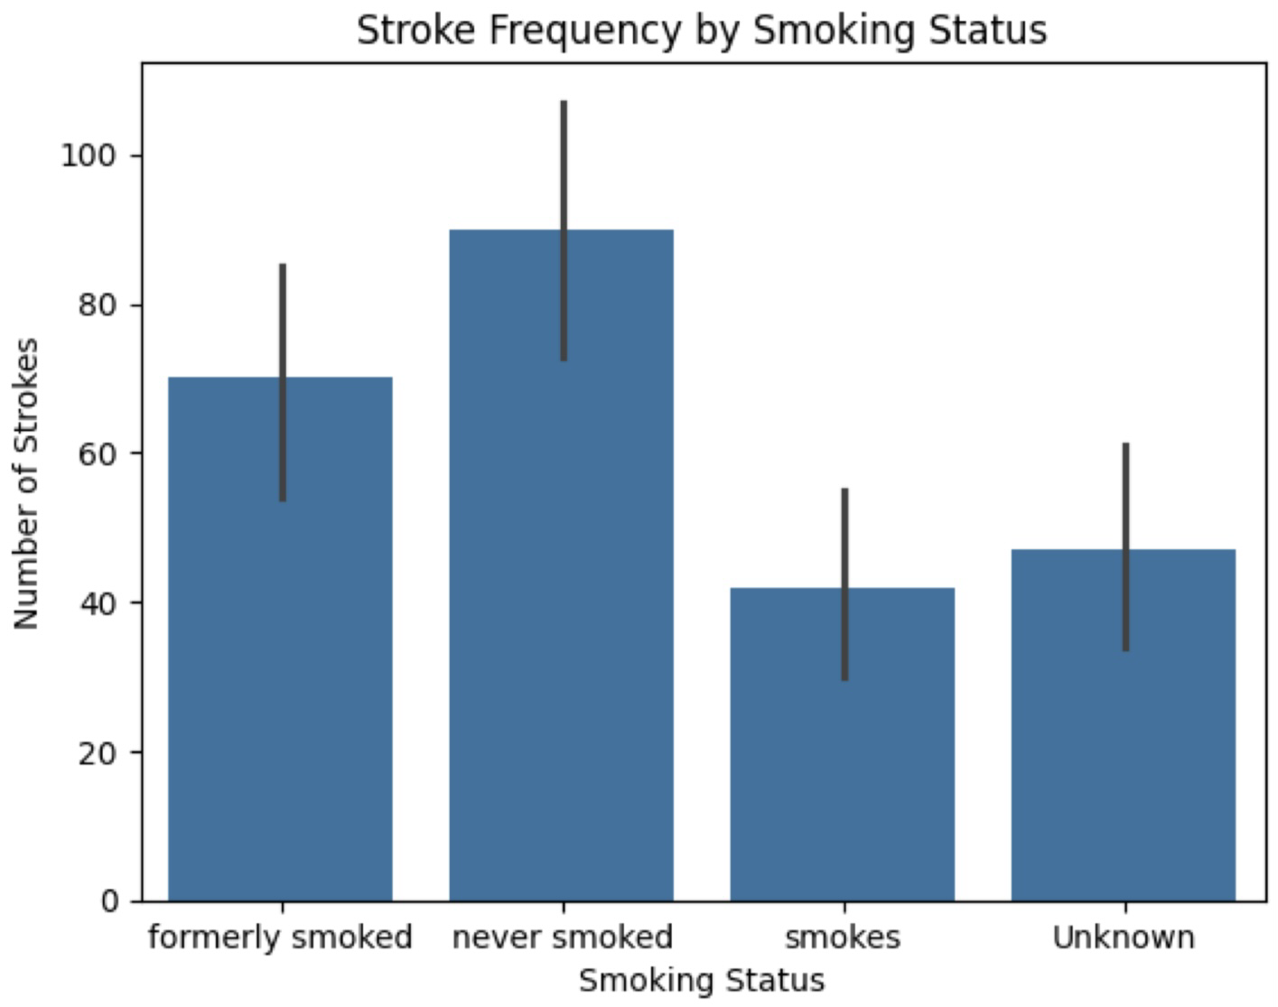
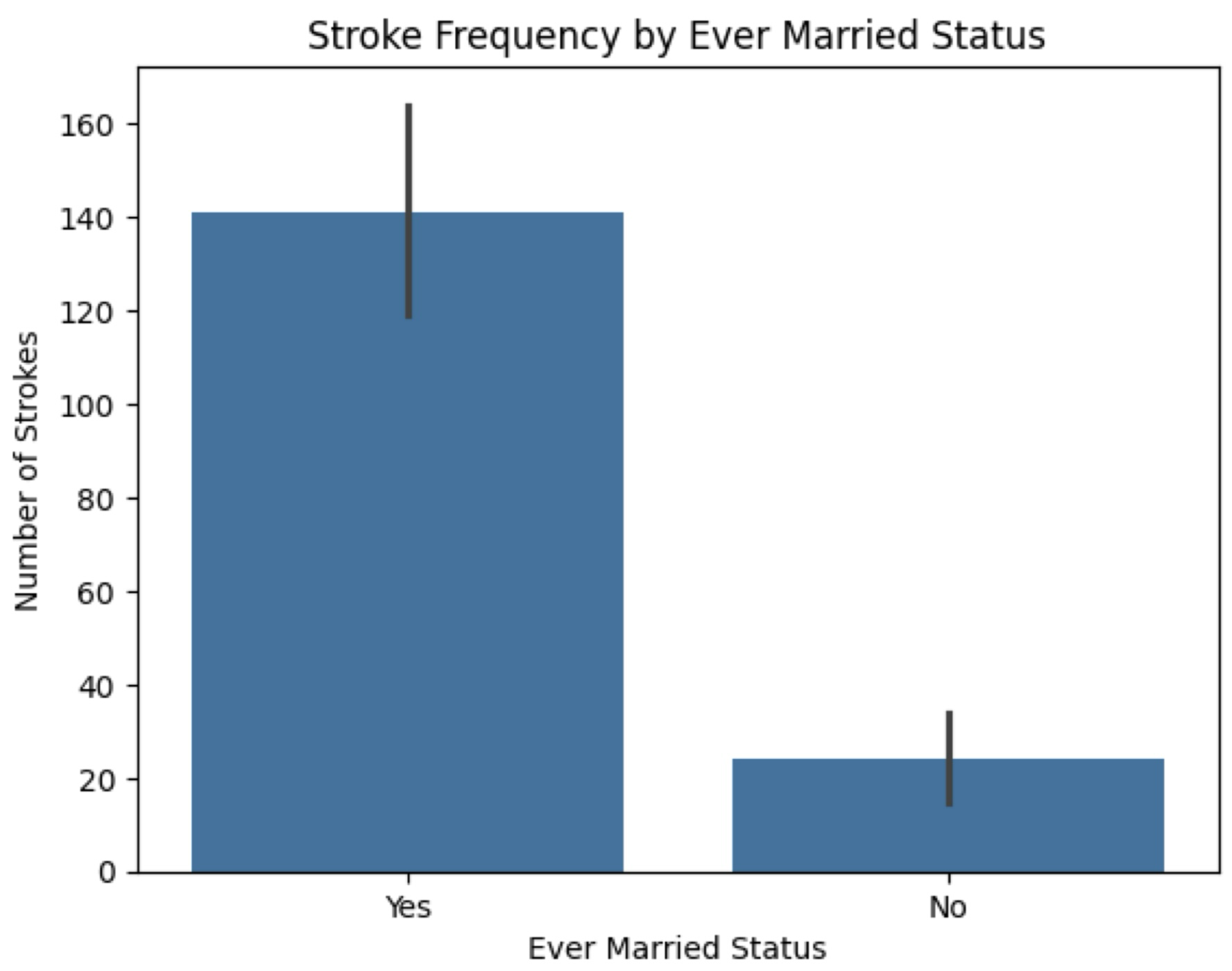
Other Factors
Other variables were also examined and tested for correlation with stroke. Like:
Smoking Statues x Stroke
Ever Married Statues x Stroke

Slide 19
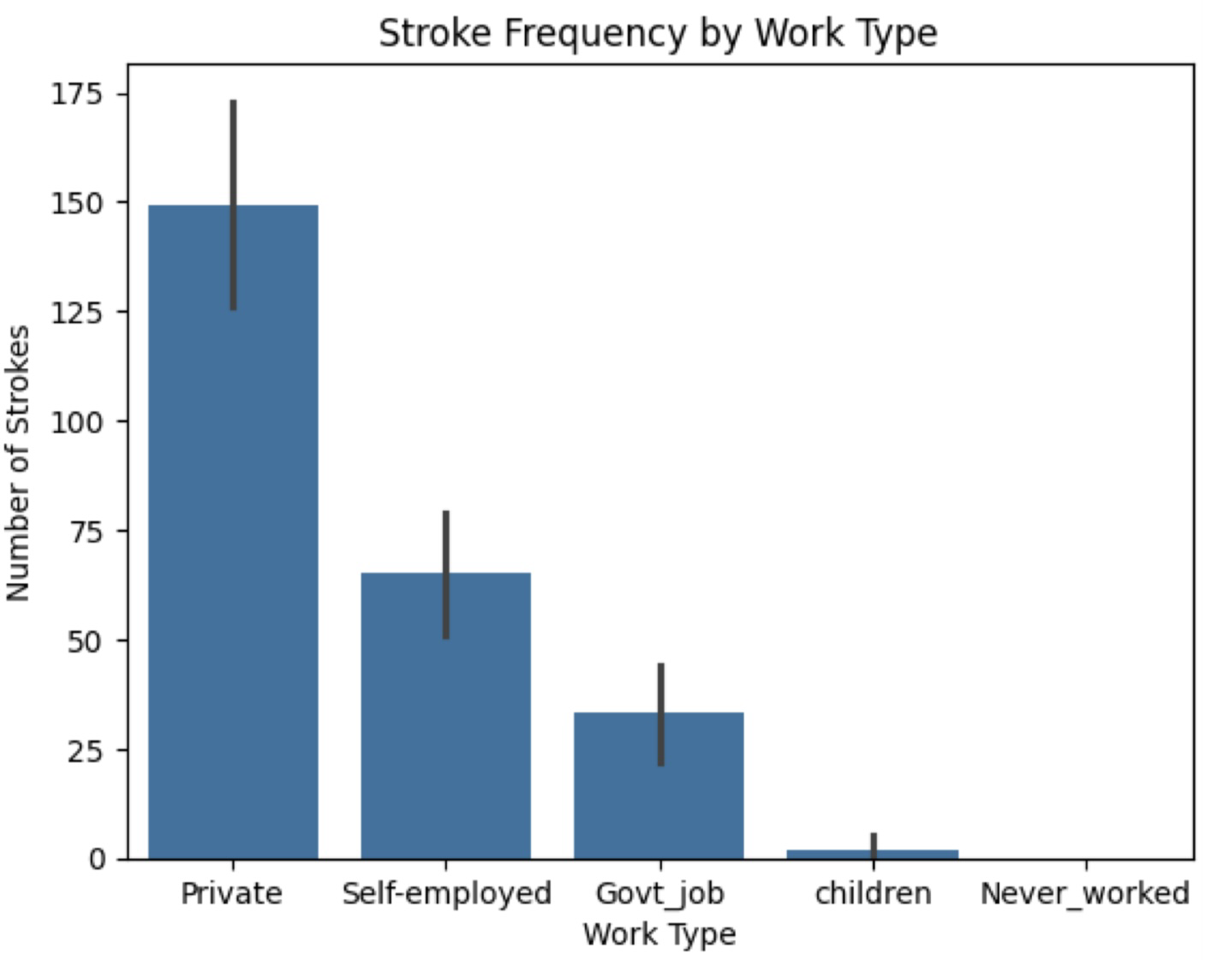
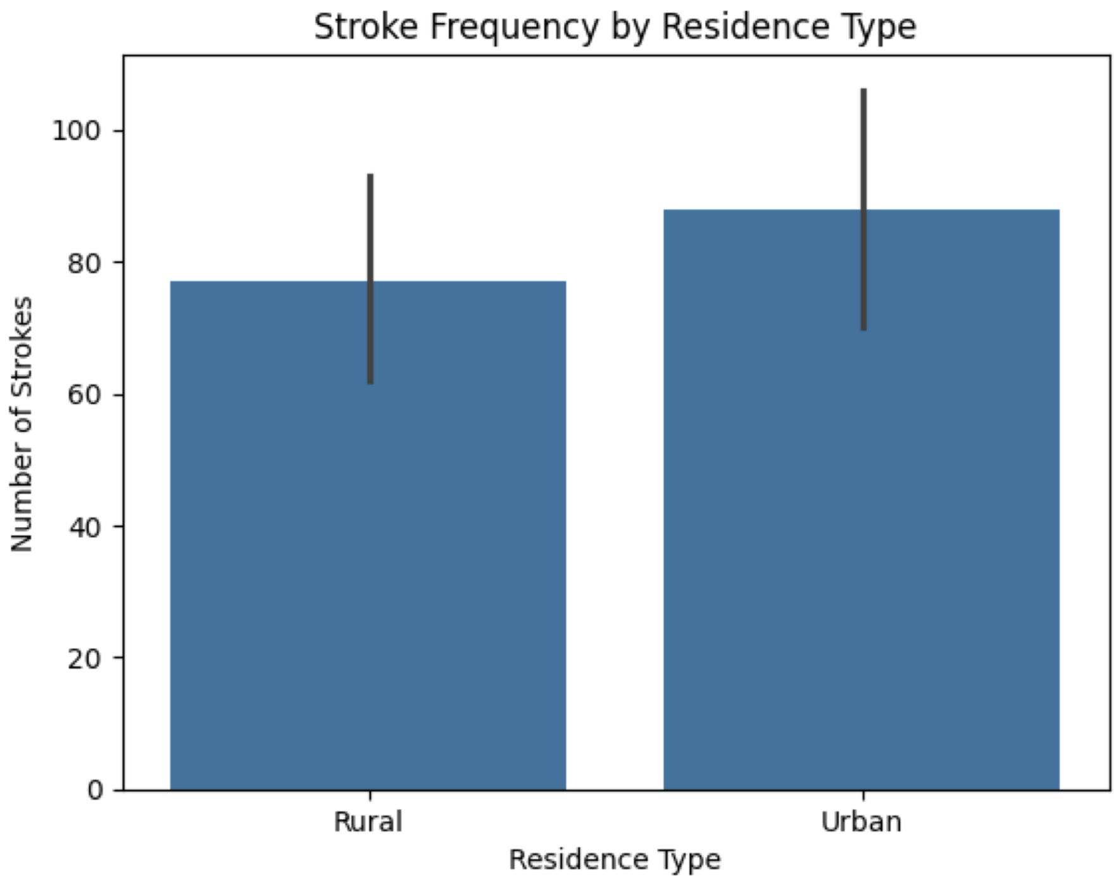
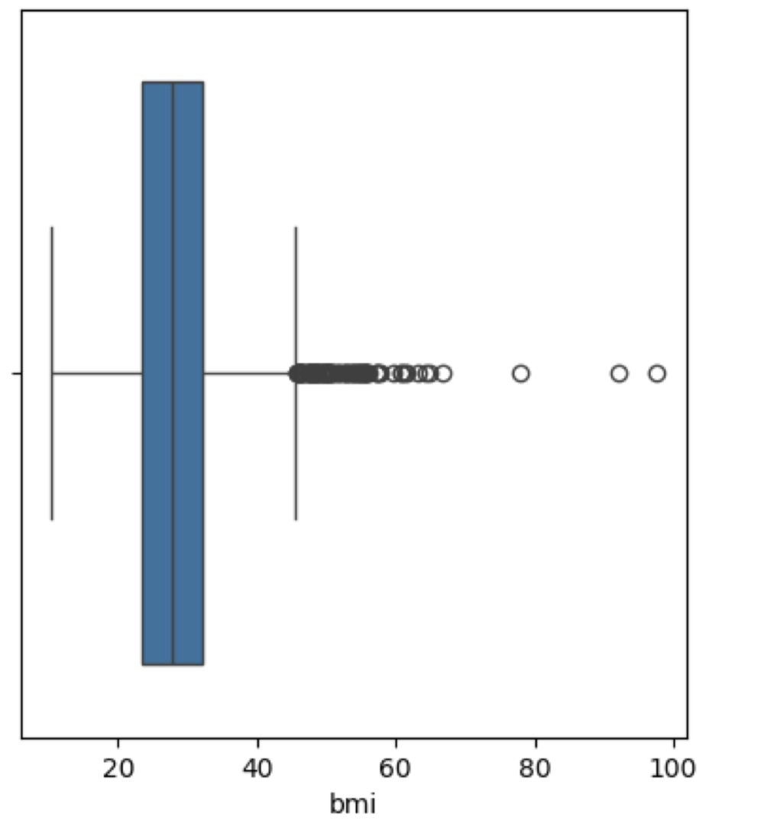
Other Factors
Other variables were also examined and tested for correlation with stroke. Like:
Work Type x Stroke
Residence Type x Stroke
BMI x Stroke

Slide 20

Correlation
04

Slide 21
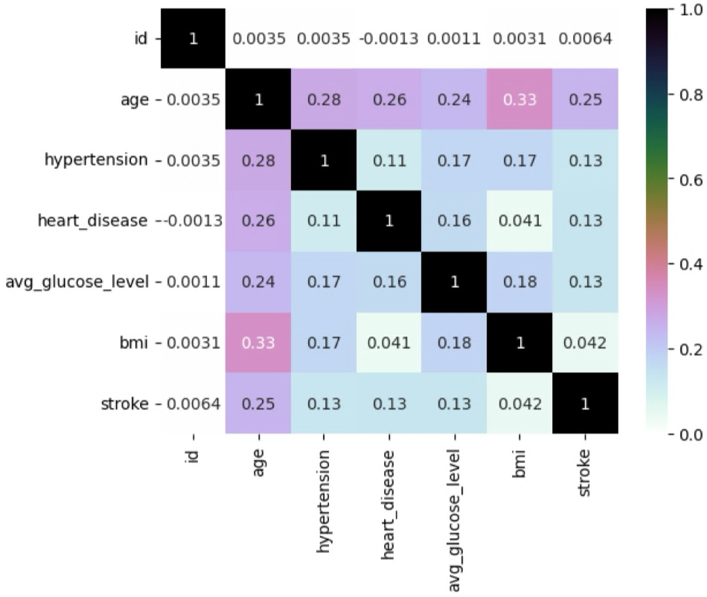
Correlation

Slide 22
CONCLUSION
05

Slide 23
CONCLUSION
It is observed that age is identified as the most significant predictor of strokes, showing a strong positive association.
Hypertension and average glucose level also correlate positively but to a lesser extent.
Gender, heart disease, and smoking statues have weaker associations, and there are no factors inversely correlated with strokes in the data.

Slide 24

THANKS
Do you have any questions?
06
Please keep this slide for attribution

